Slide 1

PRIVACY PRESERVING PUBLIC AUDITING TO SECURE CLOUD
By Vitthal S. Gutte
1326
Guided by
Mrs. Priya Deshpande

Slide 2

Agenda
Introduction
Literature Survey
Futurework
Conclusion
References

Slide 3
Introduction
Cloud computing as the next-generation architecture of IT enterprise.
In traditional IT services - physical, logical and personnel controls.
Moves the application software and databases to the large data centers.
The management of the data and services may not be fully trustworthy.

Slide 4
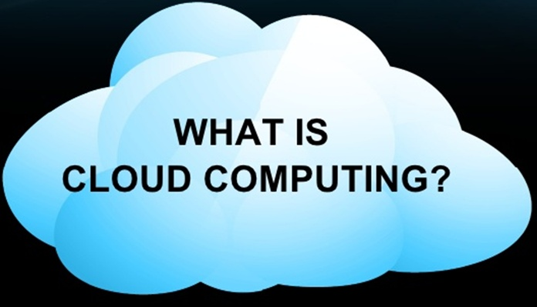
“ The utilization of computer resources that are :-
Available on demand.
Accessed via a network.
Charged according to usage.
Provided as a service from a cloud vendor”

Slide 5
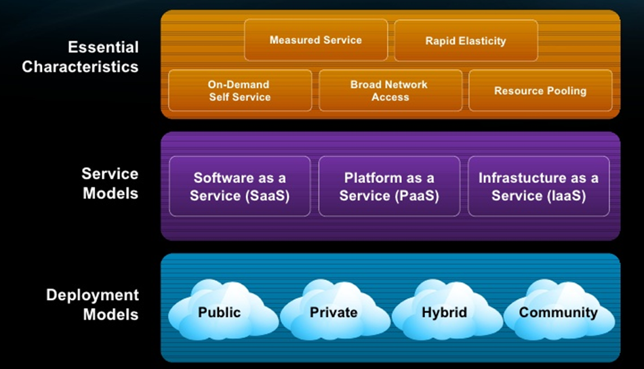
Terminologies and characteristics:

Slide 6
Literature Survey
A Privacy-Preserving Remote Data Integrity Checking Protocol with Data Dynamics and Public Verifiability [Zhuo Hao etl. 2013]
Data dynamics
Public verifiability
Privacy against verifiers

Slide 7
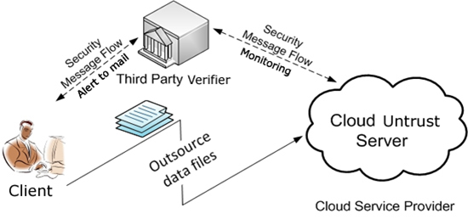

Slide 8
An Efficient and Secure Dynamic Auditing Protocol for Data Storage in Cloud Computing [Kan Yang etl. 2012]
Re-encryption key the messages are first encrypted by the owner and then stored in a storage server.
When a user wants to share his messages, he sends a re-encryption key to the storage server. The storage server re-encrypts the encrypted messages for the authorized user. Thus, their system has data confidentiality and supports the data forwarding function.
randomness.

Slide 9
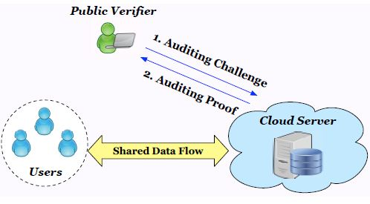
Oruta: Privacy-Preserving Public Auditing for
Shared Data in the Cloud[B. Wang etl. 2014]

Slide 10
With ring signatures, a verifier is convinced that a signature is computed using one of group members’ private keys, but the verifier is not able to determine which one
.
Homomorphic authenticators (also called homomorphic verifiable tags) are basic tools to construct public auditing mechanisms.
Blockless verifiability
Non-malleability

Slide 11
Literature Survey
Privacy-Preserving Public Auditing
for Secure Cloud Storage
[Cong Wang etl 2013]
Author propose a privacy-preserving public auditing system for data storage security in cloud computing.
User uses as a local without worry about integrity.
To speed up the auditing by TPA batch auditing scheme is introduced, which has the ability to audit the files batch wise.

Slide 12
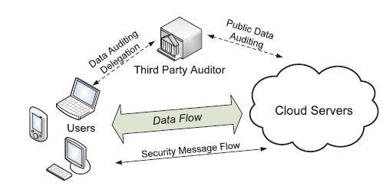

Slide 13
CHALLENGES & FUTURE DIRECTIONS
In the future work, we hope to build an efficient public auditing mechanism with the capability of preserving identity privacy and public auditing mechanism using TPA. Also we will try to introduce a secure scheme for data dynamics in such a way that for performing any transaction, client admin is not required to decrypt the records so that it saves time and the cost of bandwidth.
In order to provide client full advantage of acquiring a cloud storage service, client admin will store the VMd, private and public keys with TPA, not at their local machine, however these parameters are encoded and can be decrypted only by the privileged user.
Furthermore, we hope to optimize the system architecture and modules proposed in this paper.

Slide 14
Conclusion
We have studied various privacy issues such as data dynamics solutions, and batch auditing schemes with data integrity solutions.
In this report we discussed various data privacy preserving solution for organizations which deals with sensitive information where the TPA would not have any knowledge about the data content stored on the cloud server during the efficient auditing process, which not only eliminates the burden of cloud user from the tedious and possibly expensive auditing task, but also alleviates the user’s fear of their outsourced data being leakage.
We pointed out the issues in privacy preserving mechanism which we will work upon in the future.

Slide 15
References
Zhuo Hao, Sheng Zhong, Nenghai Yu, “A Privacy-Preserving Remote Data Integrity Checking Protocol with Data Dynamics and Public Verifiability”, IEEE Transactions on Knowledge and Data Engineering, Volume:23, pp: 1432 – 1437, 2011.
Kan Yang and Xiaohua Jia “An Efficient and Secure Dynamic Auditing Protocol for Data Storage in Cloud Computing” ,IEEE Transactions on Parallel and Distributed Systems, Volume:24,2012
B. Wang, B. Li, and H. Li, “Oruta: Privacy-Preserving Public Auditing for Shared Data in the Cloud,” IEEE Transactions on Cloud computing, pp. 43 - 56, 2014
C. Wang, S. S.-M. Chow, Q. Wang, K. Ren, and W. Lou, “Privacy preserving public auditing for secure cloud storage.” , IEEE TRANSACTIONS ON COMPUTERS, VOL. 62, NO. 2, pp: 362-375, FEBRUARY 2013

Slide 16


